Slide 1


Intro To Artificial Intelligence
Mustafa Ali– Data Engineer

Slide 2





Echo Me
Google Cloud Certified Professional Data Engineer & Machine Learning Specialist.
Karachi AI Certified Data Analyst & Data Engineer, Working at Royal Cyber Inc. as a Data Engineer.
Previously worked as Machine Learning and Computer Vision Engineer.
3+ Years of industrial experience, Responsible for designing, building and operationalizing large-scale enterprise data solutions and application on Google Cloud Platform.
Mustafa Ali Mir
Data Engineer GCP
Google Cloud Partner – Royal Cyber
Speaker @ Karachi AI, AI Summit, SSUET
engr.mustafa.ali.mir@gmail.com
linkedin.com/in/mustafaali96/

Slide 3
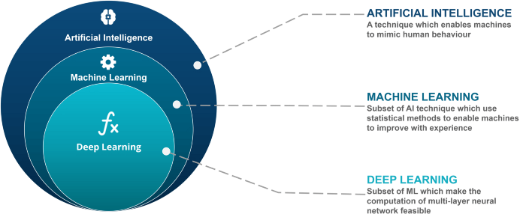
Formal Definition of Artificial Intelligence
“The theory and development of computer systems able to perform tasks normally requiring human intelligence, such as visual perception, speech recognition, decision-making, and translation between languages.”
Notes:
As it is clear from the definition above, artificial intelligence consists of computers trying to mimic the human behavior and intelligence

Slide 4
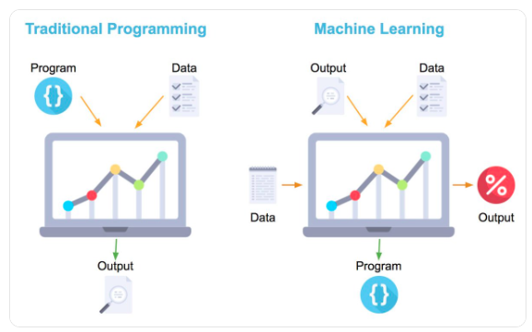
Traditional Programming vs Machine Learning
Guess the number
1 = 5
2 = ?
3 = ?
4 = ?
5 = ?
6 = ?
7 = ?
7
9
11
13
15
17
Formula:
(x * 2) + 3

Slide 5
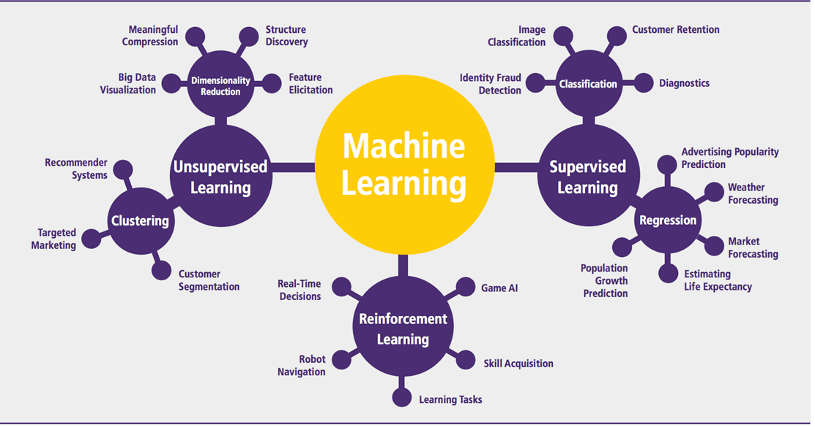

Slide 6
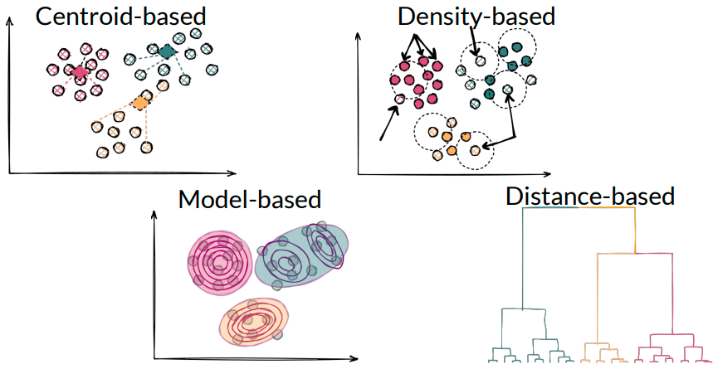
Unsupervised: Clustering

Slide 7
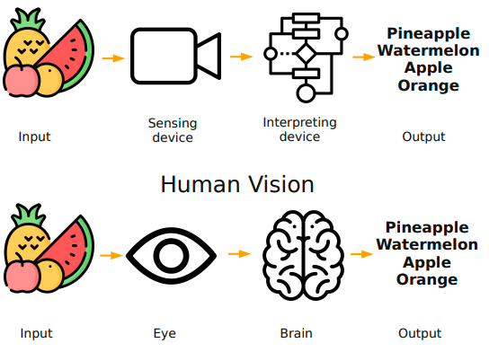
What is Computer Vision?

Slide 8
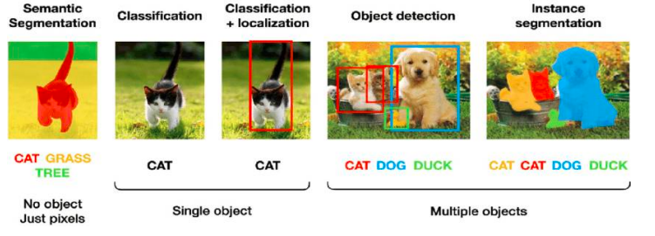
How do Computer See?

Slide 9
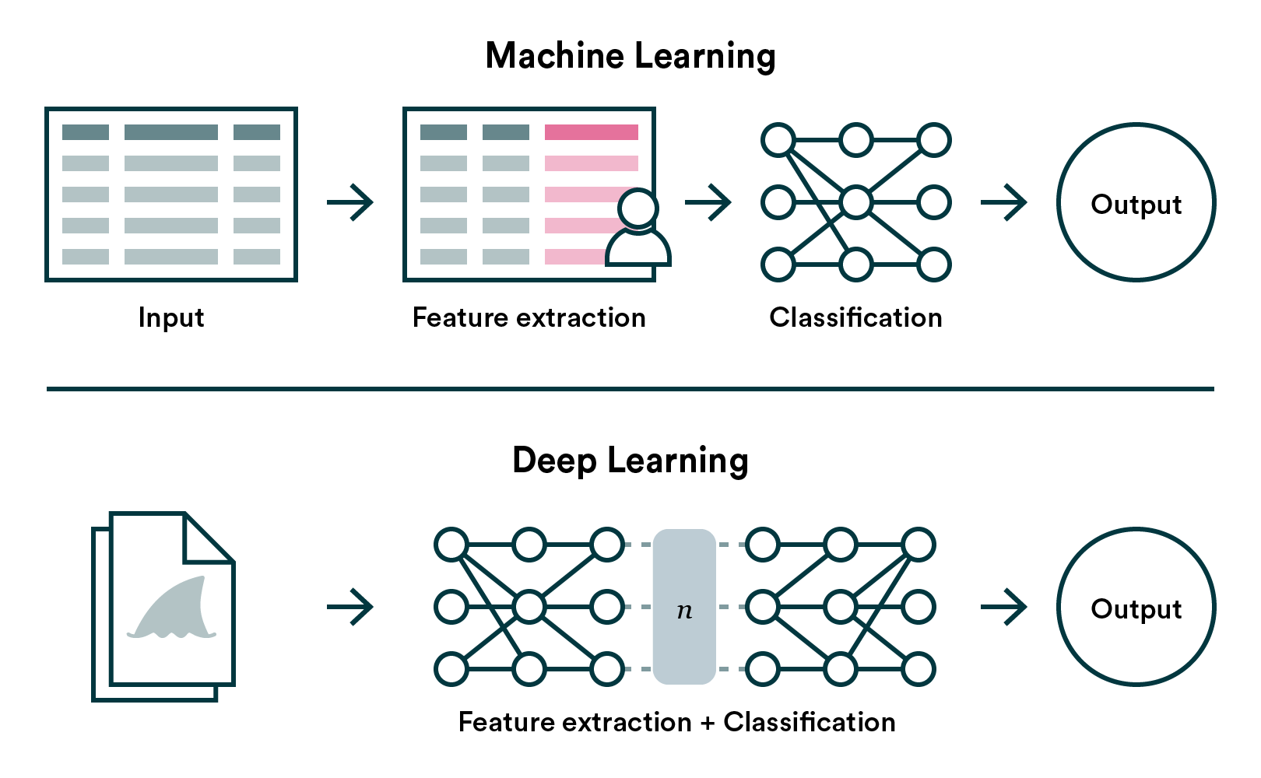

Slide 10


Slide 11


Slide 12
Typical machine learning lifecycle
Step-by-step solution of ML problem
Monitor
Model
Define Business Use Cases
Cloud Discover:
Machine Learning
Operationalize Model
Data
Exploration
Cloud Deploy Machine Learning for Production
Machine Learning Feasibility Study
Plan for Deployment
Iterate on
approach
Select
Algorithm
Present Results
Data Pipeline and Feature Engineering
Cloud Deploy Machine Learning for MVM
Evaluate
Build ML
Model

Slide 13
There are AI opportunities in every industry
Retail
Healthcare
Financial Services
Media, Entertainment, & Gaming
Industrial & Manufacturing
Public Sector
Demand Forecasting
Telehealth /
Virtual Care
Anti-Money Laundering (AML)
Hybrid Rendering & Virtual Studio
Industrial Adaptive Controls
Public Health Platform
Retail Search
Interoperability Accelerator
Know Your Customer (KYC)
Media Asset Management
Manufacturing Visual Inspection
Transit Reopening
Recommendations
Hospital Impact Forecasting
Lending Doc Processing
Media Distribution
Logistics Optimization
Digital Social Safety Nets
Inventory Optimization
Biomedical Data Analytics
Risk Analytics
Game Servers
Connected Operations
Virtual Government
Functional Solutions: Contact Center AI, Document AI
Notes:
AI opportunities span across multiple industries, from Retail to Manufacturing to health care.
There are hundreds of Business critical use cases
Our Goal with Google Cloud AI is to Empower every Enterprise to transform their Business through AI
As you can see we have so many business critical use cases.. In Retail itself the AI spend is expected to be $7.3 Billion by 2022
A recent report released by Capgemini's Research Institute estimated that global annual spending on AI by retailers is estimated to reach $7.3 billion by 2022.
Manufacturing - Supply chain optomization is a key use case
In Healthcare we are barely scratching the surface.. Opportunities from Genome Analysis to Transforming healthcare delivery to patients Imagine the potential here
Training 3D medical imaging models…
Computer vision against X-rays shows promises to help pinpoint diseases; AI shows promises in detecting drug safety; ML shows promises to find patterns within a population
Example use-cases across industries

Slide 14
Language
Translation and natural language
Easy-to-deploy AI applications
Sight
Vision and video intelligence
Content management & archives
Localization
Content classification
Sentiment analysis
Image & video search
Document classification
Industrial inspection
Entity extraction

Slide 15






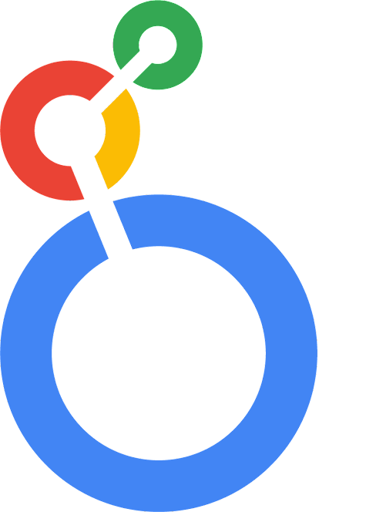






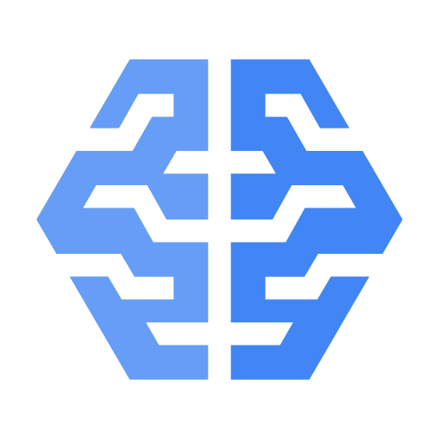

A platform for all users and intents throughout the ML lifecycle
Product Manager
Insights and objectives
Data analyst
Query and analyze
Data engineer
Get clean, useful data
Data scientist
Models that work
ML developer
Intelligent apps
ML engineer
Models in production
Interactive BI
Looker
Endless EDW
BigQuery
Self-driving infra
BigQuery, Dataflow, Composer
Portable notebooks
AI Platform Notebooks
Images, videos
Vision, Video Intelligence
Scalable model hosting
AI Platform Prediction
EDW in a Spreadsheet
Connected Sheets
Self-managed data pipelines
Data Fusion, Dataflow
Broad choice of tools/language
Dataproc, Dataflow
Model eval and selection
Explainable AI, Experiments
Sentiment analysis, entity extraction
NL, Translation
ML CI/CD and orchestration
AI Platform Pipelines
Natural Language Query
Data QnA
Data models, catalog
Looker, Data Catalog
Data quality /lineage
AI Platform, BigQuery, Dataflow
Point-and-click dev
AutoML
Chatbots, voice commands
Conversation
Provenance and lineage
ML Metadata Management
Machine learning in SQL
BigQuery ML
Real-time capabilities
BigQuery, Dataflow
Collaboration
Feature Store, AI Platform Pipelines
Fleet routing, forecasting
Optimization
Improvements and retraining
Continuous Monitoring
Notes:
There are many users within an organization who have a part to play in the ML lifecycle. Consider a product manager, who can simply type a natural language query using our Data QnA to pull necessary insights from BigQuery. To a data scientist who dabbles with different aspects of building and validating models. To an ML engineer who is responsible for the model to work without issues to end users in production systems. There are several users with different needs, and we have thoughtfully built a comprehensive platform to serve them all.

Slide 16


What & Why Low Code / No Code Tools
Built a fully-developed solution without writing a Code
Improve time to value
Increase business value
Enable to rapidly deploy analytics and AI to solve their business challenges
Realize the maximum potential of their analytics and AI technology initiatives
Increase speed of solution delivery
Focus resources on solving business challenges, not technical ones
Serverless platform removes complexities of tuning, configuration, provisioning, and more
Incorporate more data sources into analysis and AI models
Quickly deploy models into production via Cloud AI platform
Deliver more models and automation across the business via speed of development/ease of use

Slide 17

Use Cases & Demos

Slide 18
Confusion Matrix
Cancer Detection
If a person don’t has cancer and your model predicted – no cancer TN
If a person has cancer and your model predicted – no cancer FN
If a person has cancer and your model predicted – cancer TP
If a person don’t has cancer and your model predicted – cancer FP
False Neg. -> Decrease > Recall = TP / (TP + FN)
Container Inspection Case Study
If container don’t have illegal item and your model predicted – safe TN
If container have illegal item and your model predicted – safe FN
If container have illegal item and your model predicted – not safe TP
If container don’t have illegal item and your model predicted – not safe FP
False Pos. -> Decrease > Precision = TP / (TP + FP)

Slide 19
What is MLOps ?
“ML Ops is an ML engineering culture and practice that aims at unifying ML development (Dev) and ML operation (Ops)”
MLOps empowers data scientists and app developers to help bring Machine Learning models to production.
MLOps enables you to track / version / audit / certify / re-use every asset in your ML lifecycle.

Slide 20
The MLOps life cycle
Data Management All ML focused tasks to explore, manage and create data(sets).
Modelling All pipeline related tasks from data processing to trained model validation.
Continuous Deployment All tasks related to the "Ops" part of MLOps - launching, monitoring and securing productive models.
Computing & Resources All activities and functions related to computing and resource management.
Notes:
The MLOps life cycle includes 4 major areas

Slide 21
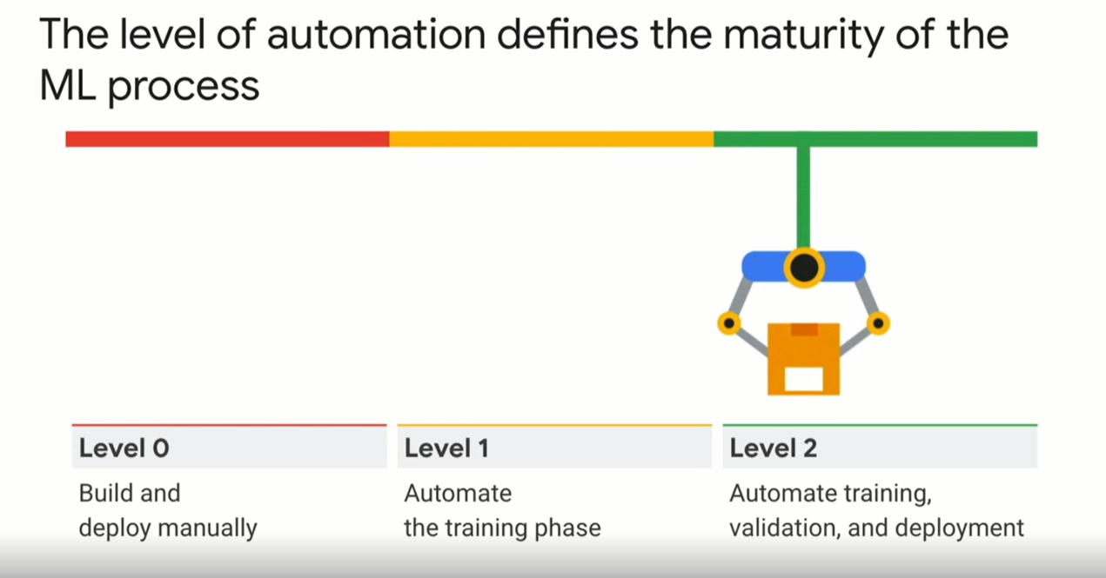

Slide 22
AI Use Cases​
Understanding the customer journey​
Trendspotting ​
Churn is highest on Sunday mornings​
Spike in searches for electronic sensor
On Sundays Chicago area ad spend is 30% higher but web traffic is 50% lower as compared to in-store traffic. ​
Customer Segmentation​
Highest historical spenders​
Online shoppers only​
Heavy browser users that don't log in​
Heavy couponers
Predicting Marketing Outcomes
Lifetime Value Prediction​
Send retention offer to customers who are likely to churn​
Stream data to DMP platforms like Google & FB to find lookalike for high LTV customers​
Exclude low LTV customers from high spend associated campaigns for eg. Video – YT campaigns​
Purchase Prediction​
Convert predictions by user & product​
Predict user propensity scores
Personalize the customer experience
Sentiment Monitoring ​
Customize marketing message to customers mood​
Data Driven Segmentation​
Use AutoML algorithms to cluster customers by behavior​
Personalization engine​
5% of increase in retention can lead to 25-100% of increase in revenue {focus on personalization}​

Slide 23
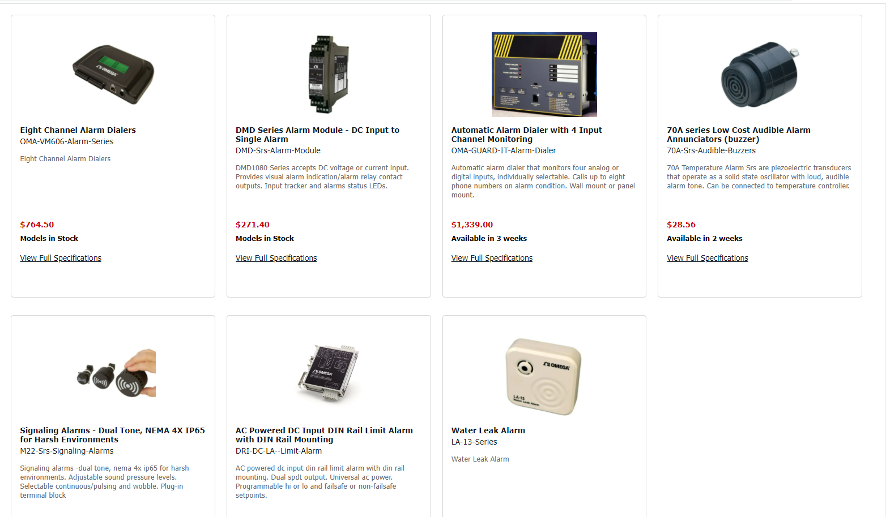
Personalized Recommendations
Know more about your customers!
Gathering data from your customer’s previous activities to predict what they would like to buy and make recommendations.
Collaborative filtering:
A picture of Omega’s user based on shopping patterns and behaviors and then recommend other products to that user based on what people with the same profile have purchased.
Recommended for you, Nikhil
Notes:
Signed in or cookie activity people should be kept track and give recommendation.
This week buys / products about run out/ : recommendations
Bring in Machine learning. Recommendations based on data; now let the machine learn and track; computational power unparalleled train it for the right category of data. Data over the years collected (730 data points per consumer) can be used to train the MLmodels

Slide 24
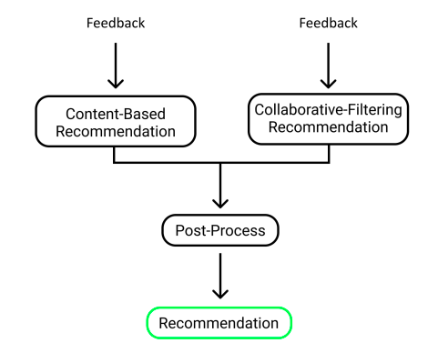
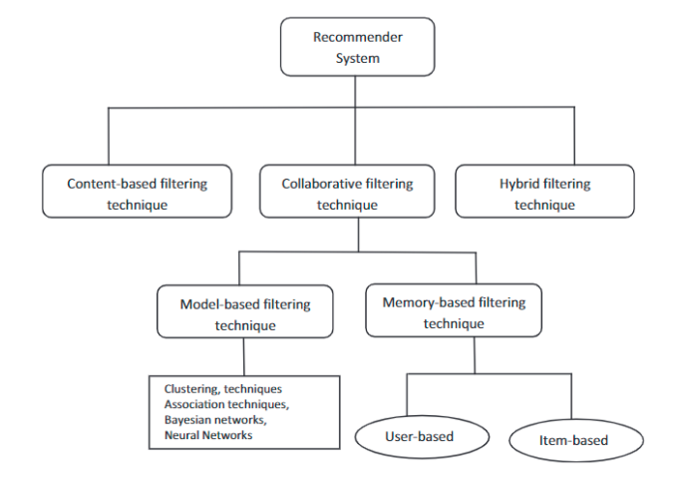
Feedback based Recommendation
E-commerce often has to rely on Implicit or Explicit feedback. With the use of hybrid feedback we can increase our revenue
With the use of consumer behaviour logs, E-commerce sitescan make use of recommendations systems like:
Cross Sell: Recommend additional products to increase
average order size over time.
Loyalty: Personalize the website to build user-site relationship, which trains the system to build better recommendations.

Slide 25

“Artificial Intelligence, Deep learning, Machine learning — whatever you’re doing if you don’t understand it — learn it. Because otherwise you’re going to be a dinosaur within 3 years.” ~Mark Cuban
Mustafa Ali Mir
Data Engineer Google Cloud Platform
Google Cloud Partner – Royal Cyber
Ambassador – Karachi AI
Email: engr.mustafa.ali.mir@gmail.com
LinkedIn: linkedin.com/in/mustafaali96/
Facebook: https://facebook.com/MustafaAliMir96
Website: https://mustafa-ali-mir.herokuapp.com/

Slide 26

That’s a wrap. Thanks!

